Slide 1
Programming Languages -1
(Introduction to C) structures
Instructor: M.Fatih AMASYALI
E-mail:mfatih@ce.yildiz.edu.tr

Slide 2
Introduction
Structures
  A collection of one or more variables, possibly of different types, grouped together under a single name for convenient handling.
  Example:
      struct card {
      char *face;
      char *suit;
      };
  struct introduces the definition for structure card
  card is the structure name and is used to declare variables of the structure type
  card contains two members of type char *
    These members are face and suit
  Comparing structures is a syntax error.

Slide 3
Structure Definitions
Example:
A date consists of several parts, such as the day, month, and year, and the day of the year, and the month name
      struct date {
        int day;
        int month;
        int year;
        int year_date;
        char month_name[4];
        };
  date: the name of the structure, called structure tag.
  day, month, …: the elements or variables mentioned in a structure are called members.
struct information
  A struct cannot contain an instance of itself
  Can contain a member that is a pointer to the same structure type
  A structure definition does not reserve space in memory

Slide 4
Declarations
  method 1: declared like other variables: declare tag first, and then declare variable.
  struct card {
  char *face;
  char *suit;
  };
  struct card oneCard, deck[ 52 ],*cPtr;
  method 2: A list of variables can be declared after the right brace and use comma separated list:
  struct card {
  char *face;
  char *suit;
  } oneCard, deck[ 52 ], *cPtr;
struct date {
.. .. ..
} d1, d2, d3;
struct date d4, d5;

Slide 5
Valid Operations
  Assigning a structure to a structure of the same type
  Taking the address (&) of a structure
  Accessing the members of a structure
  Using the sizeof operator to determine the size of a structure
Initialization of Structures
  Initializer lists
    Example:
      struct card oneCard = { "Three", "Hearts" };
    Example:
      struct date d1 = {4, 7, 1776, 186, “Jul”};
      struct date d2 = {4, 7, 1776, 186, {‘J’,’u’,’l’,’\0’}};
  Assignment statements
    Example:
      struct card threeHearts = oneCard;

Slide 6
typedef
  Creates synonyms (aliases) for previously defined data types
  Use typedef to create shorter type names
  Example:
      typedef struct card *CardPtr;
  Defines a new type name CardPtr as a synonym for type struct card *
  typedef does not create a new data type while it only creates an alias

Slide 7
Structures – initialize
You may initialize a variable corresponding to a structure that was defined by initializing all its elements as follows:
struct name var = {init_element_1, …, init_element_n}
#include <stdio.h>
struct address_struct
{ char *street;
char *city_and_state;
long zip_code;
};
typedef struct address_struct address;
void main()
{
address a = { "1449 Crosby Drive", "Fort Washington, PA", 19034 };
}

Slide 8
  Initialization of structure array
  struct person_data{
  char name[NAMESIZE];
  int tscore;
  int math;
  int english;
  } person[]={
  {“Jane”,180,89,91},
  {“John”,190,90,100},
  .. .. .. ..
  }; /* similar to 2D array */
the inner brace is not necessary
“Jane”,180,89,91,
“John”,190,90,100,
.. .. .. ..
⇒

Slide 9
Accessing structure members
  Dot (.) is a member operator used with structure variables
    Syntax: structure_name.member
    struct card myCard;
    printf( "%s", myCard.suit );
    One could also declare and initialize threeHearts as follows:
      struct card threeHearts;
      threeHearts.face = “Three”;
      threeHearts.suit = “Hearts”;
  Arrow operator (->) used with pointers to structure variables
      struct card *myCardPtr = &myCard;
      printf( "%s", myCardPtr->suit );
    myCardPtr->suit is equivalent to (*myCardPtr).suit

Slide 10
If p is a pointer to a structure and x is an element of the structure then to access this element one puts: (*p).x or more commonly p->x
struct card_struct
{ int pips;
char suit;
};
typedef struct card_struct card;
void set_card( card *c )
{ c->pips = 3;
c->suit = ‘A’;
}
void main()
{ card a;
set_card( &a );
}

Slide 11
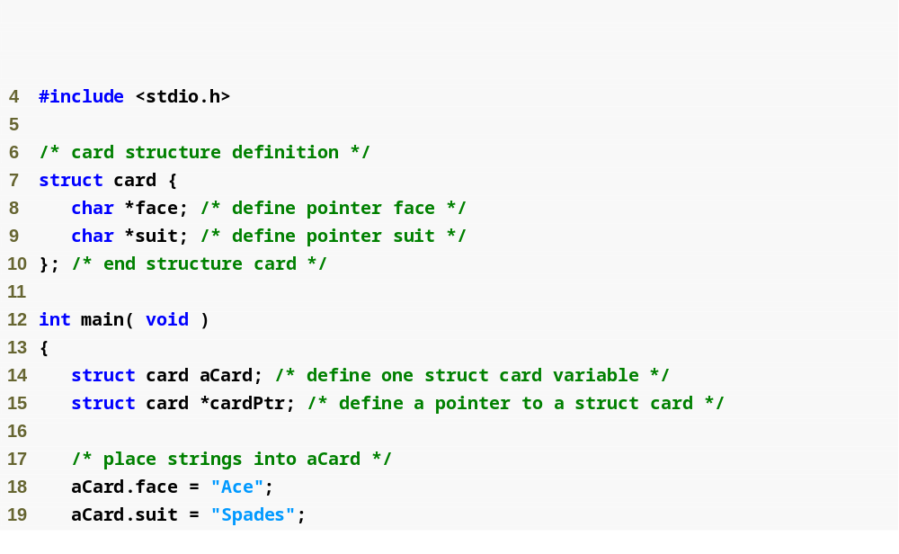
Structure definition
Structure definition must end with semicolon
Dot operator accesses members of a structure

Slide 12
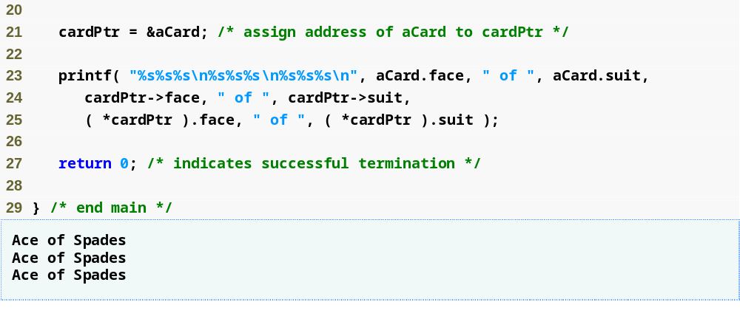
Arrow operator accesses members of a structure pointer

Slide 13
Structure can be nested
  struct date {
    int day;
    int month;
    int year;
    int year_date;
    char month_name[4];
    };
  struct person {
  char name [NAME_LEN];
  char address[ADDR_LEN};
  long zipcode;
  long ss__number;
  double salary;
  struct date birthday;
  };
  struct person emp;
  emp.birthday.month = 6;
  emp.birthday.year = 1776;
Name Rule
  Members in different structure can have the same name, since they are at different position.
  struct s1 {
    .. .. .. ..
    char name[10];
    .. .. .. ..
    } d1;
  struct s2 {
  .. .. .. ..
    int name;
  .. .. .. ..
  } d2;
  struct s3 {
    .. .. .. ..
    int name;
    struct s2 t3;
    .. .. .. ..
    } d3;
  float name;

Slide 14
Point in rectangular
  struct point {int x,y;};
  struct rect {struct point pt1, pt2;};
  int ptinrect (struct point p, struct rect r)
  { return p.x>=r.pt1.x && p.x<r.pt2.x
  && p.y>=r.pt1.y && p.y<r.pt2.y
  }

Slide 15
midpoint
  struct point midpoint (struct point a, struct point b)
  {
  struct m = {(a.x+b.x)/2, (a.y+b.y)/2};
  return m;
  }

Slide 16
Card Shuffling and Dealing Simulation
Pseudocode:
  Create an array of card structures
  Put cards in the deck
  Shuffle the deck
  Deal the cards

Slide 17
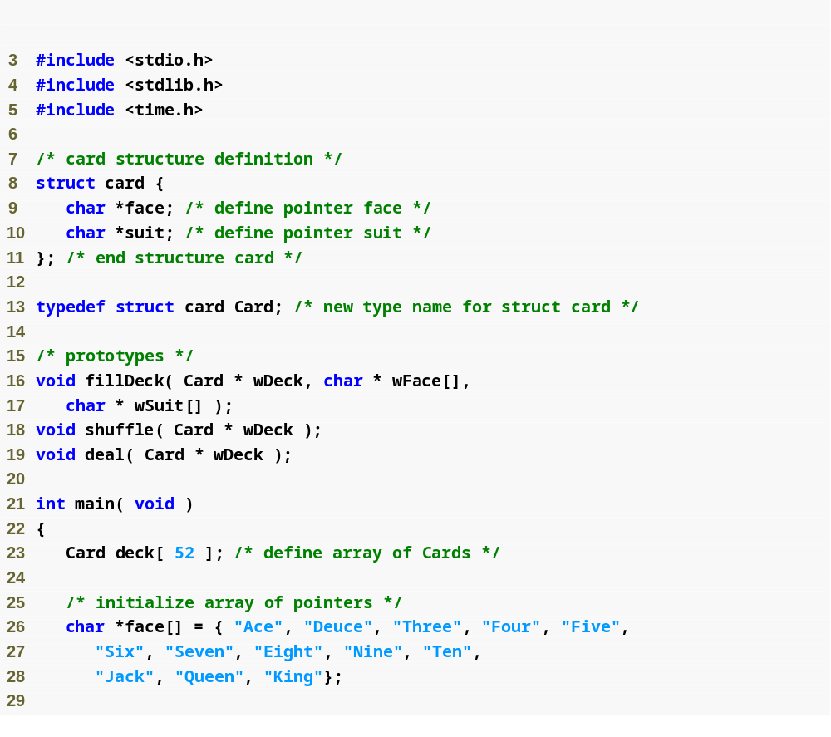
Each card has a face and a suit
Card is now an alias for struct card

Slide 18
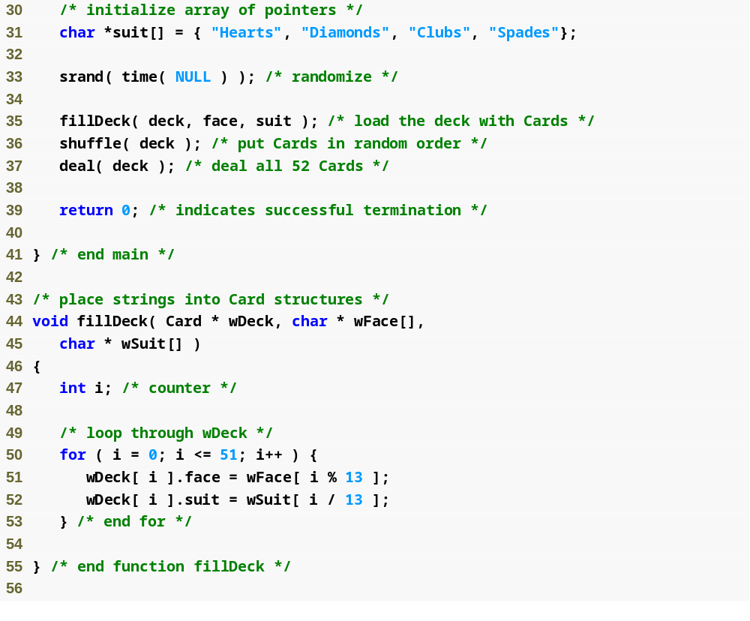
Fills the deck by giving each Card a face and suit

Slide 19
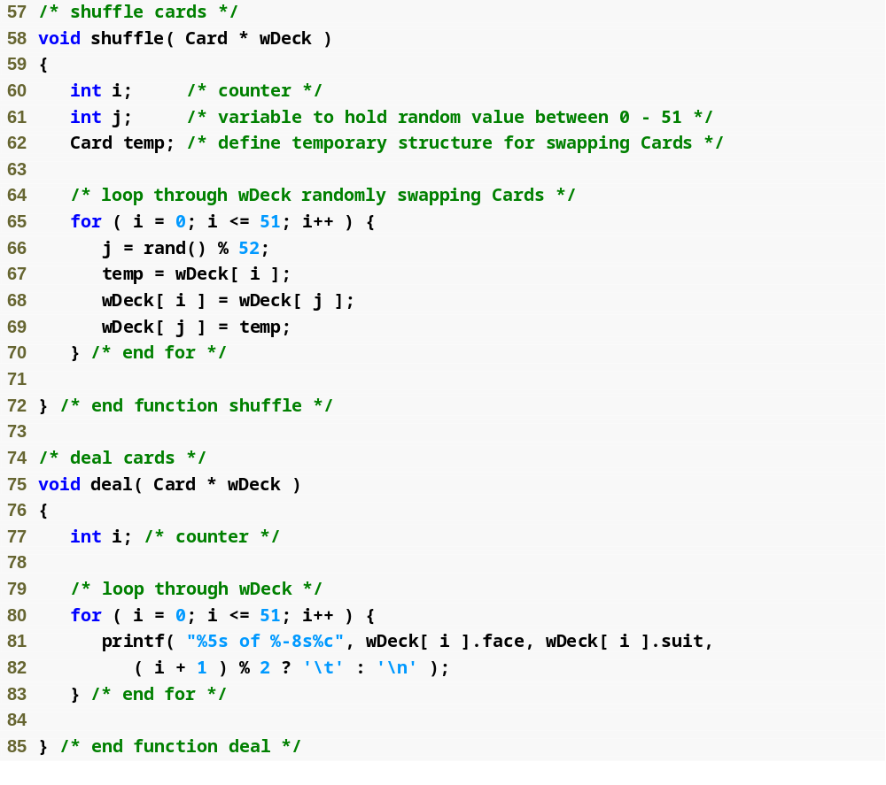
Each card is swapped with another, random card, shuffling the deck

Slide 20
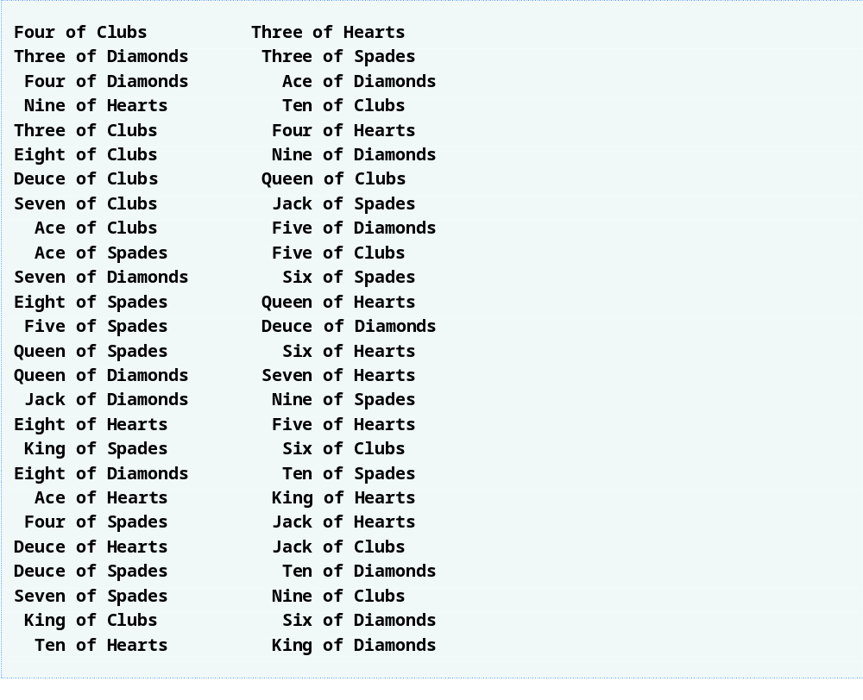
Outline

Slide 21
Unions
Similar to structures, but they can only hold one of the elements at a time
So they use the same spot in memory to save any of the possible elements.
Memory for union is max of memory needed for each element
union int_or_float
{
int i;
float f;
};
union int_or_float a;

Slide 22
3 #include <stdio.h>
4
5 union number {
Define union
6 int x;
7 double y;
8 };
9
10 int main()
11 {
Initialize variables
Set variables
Print
12 union number value;
13
14 value.x = 100;
15 printf( "%s\n%s\n%s%d\n%s%f\n\n",
16 "Put a value in the integer member",
17 "and print both members.",
Program Output
18 "int: ", value.x,
19 "double:\n", value.y );
Put a value in the integer member
and print both members.
int: 100
double:
-92559592117433136000000000000000000000000000000000000000000000.00000
Put a value in the floating member
and print both members.
int: 0
double:
100.000000
20
21 value.y = 100.0;
22 printf( "%s\n%s\n%s%d\n%s%f\n",
23 "Put a value in the floating member",
24 "and print both members.",
25 "int: ", value.x,
26 "double:\n", value.y );
27 return 0;
28 }

Slide 23
Memory Allocation Functions
All functions are declared in <stdlib.h>
void *malloc(size) allocates size bytes and returns a pointer to the new space if possible; otherwise it returns the null pointer.
void *calloc(n, size) is same as malloc(n*size), but the allocated storage is also zeroed (it is slower).
void *realloc(void *ptr, size) changes size of previously allocated object to size and returns pointer to new space is possible (or NULL otherwise)
void free(void *ptr) deallocates previously allocated storage

Slide 24
Some suggestions and comments
The NULL pointer is a pointer that points to nothing. So if p=NULL; then the statement *p is going to produce a run-time error.
void * is a generic pointer type that is returned by all memory functions.
By generic one means that void * covers all possible pointers that exist and thus by declaring a pointer as generic (void *) you suggest that it can accommodate any possible pointer type!

Slide 25
Getting an array of numbers
#include <stdio.h>
void main()
{
int *numbers, size, i, sum = 0;
printf( "How many numbers? " );
scanf( "%d", &size );
numbers = malloc( size * sizeof( int ));
for( i = 0; i < size; i++ )
{
scanf( "%d", &numbers[i] );
}
for( i = 0; i < size; i++ )
{
sum += numbers[i];
}
printf( "%d\n", sum );
free( numbers );
}

Slide 26
Enumeration
  Set of integer constants represented by identifiers
  Enumeration constants are like symbolic constants whose values are automatically set
    Values start at 0 and are incremented by 1
    Values can be set explicitly with =
    Need unique constant names
  Example:
  enum Months { JAN = 1, FEB, MAR, APR, MAY, JUN, JUL, AUG, SEP, OCT, NOV, DEC};
    Creates a new type enum Months in which the identifiers are set to the integers 1 to 12

Slide 27
3 #include <stdio.h>
4
5 enum months { JAN = 1, FEB, MAR, APR, MAY, JUN,
6 JUL, AUG, SEP, OCT, NOV, DEC };
7
8 int main()
9 {
10 enum months month;
11 const char *monthName[] = { "", "January", "February",
12 "March", "April", "May",
1 January
2 February
3 March
4 April
5 May
6 June
7 July
8 August
9 September
10 October
11 November
12 December
13 "June", "July", "August",
14 "September", "October",
15 "November", "December" };
16
17 for ( month = JAN; month <= DEC; month++ )
18 printf( "%2d%11s\n", month, monthName[ month ] );
19
20 return 0;
21 }

Slide 28
Bitwise Operators
All data is represented internally as sequences of bits
  Each bit can be either 0 or 1
  Sequence of 8 bits forms a byte

Slide 29
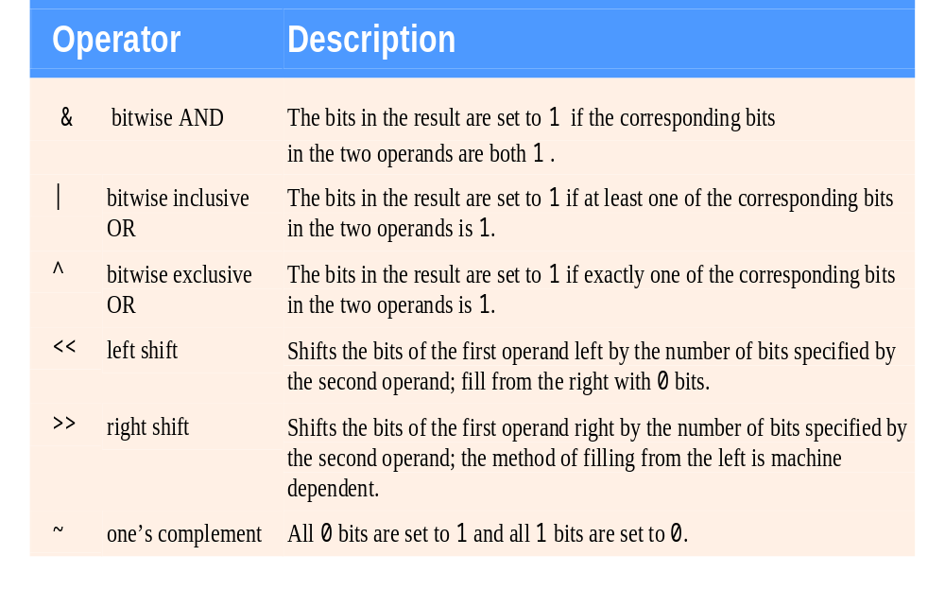
Bitwise operators.

Slide 30
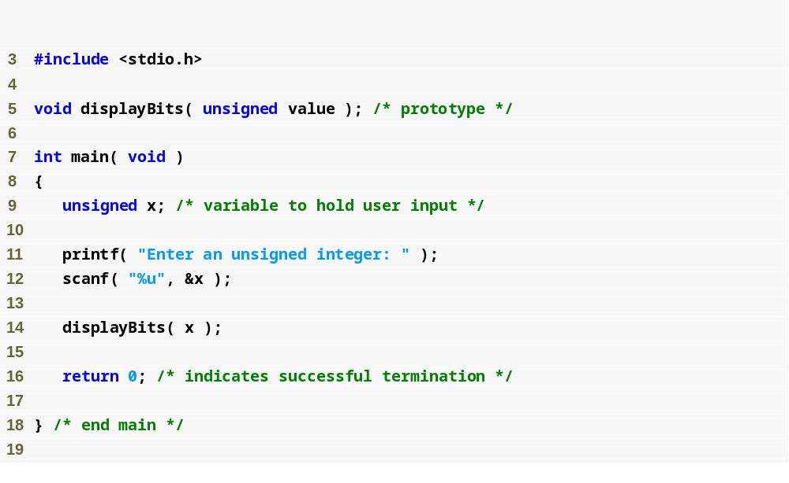

Slide 31
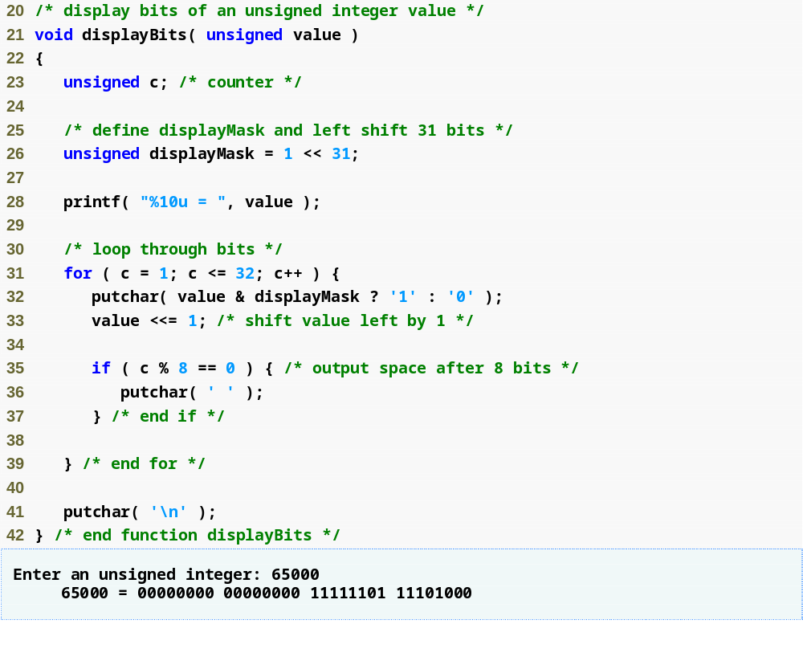
displayMask is a 1 followed by 31 zeros
Bitwise AND returns nonzero if the leftmost bits of displayMask and value are both 1, since all other bits in displayMask are 0s.

Slide 32
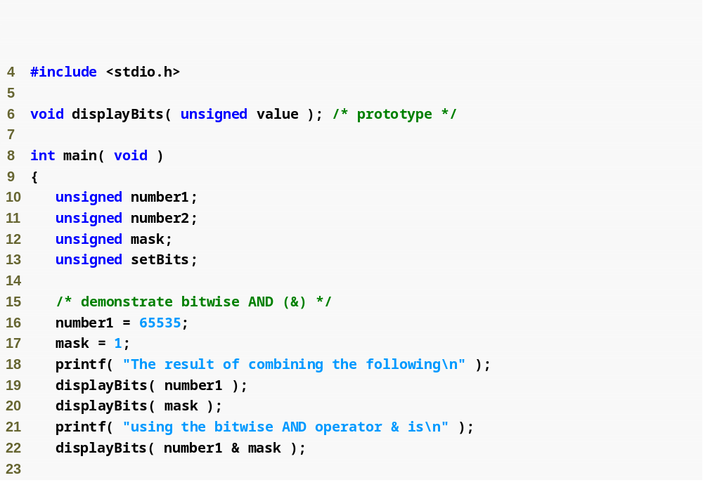
Bitwise AND sets each bit in the result to 1 if the corresponding bits in the operands are both 1

Slide 33
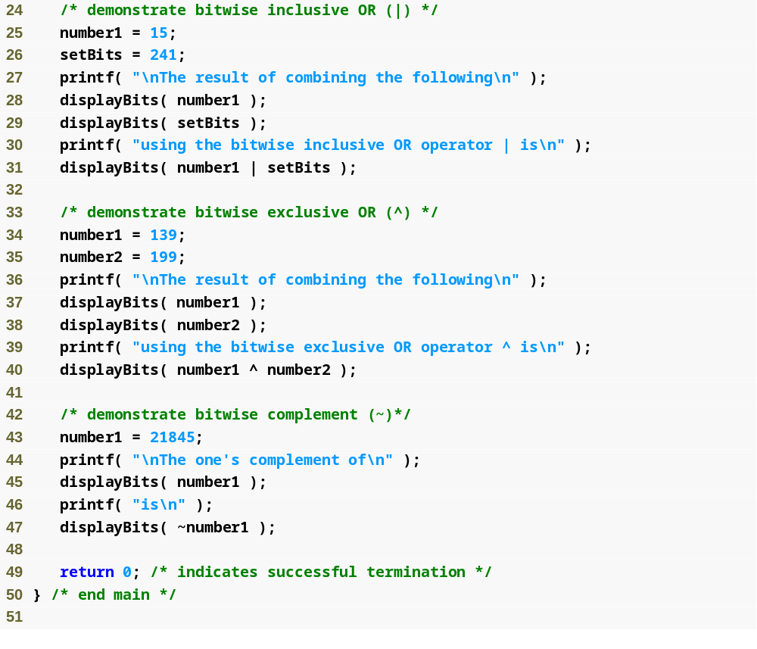
Bitwise inclusive OR sets each bit in the result to 1 if at least one of the corresponding bits in the operands is 1
Bitwise exclusive OR sets each bit in the result to 1 if only one of the corresponding bits in the operands is 1
Complement operator sets each bit in the result to 0 if the corresponding bit in the operand is 1 and vice versa

Slide 34
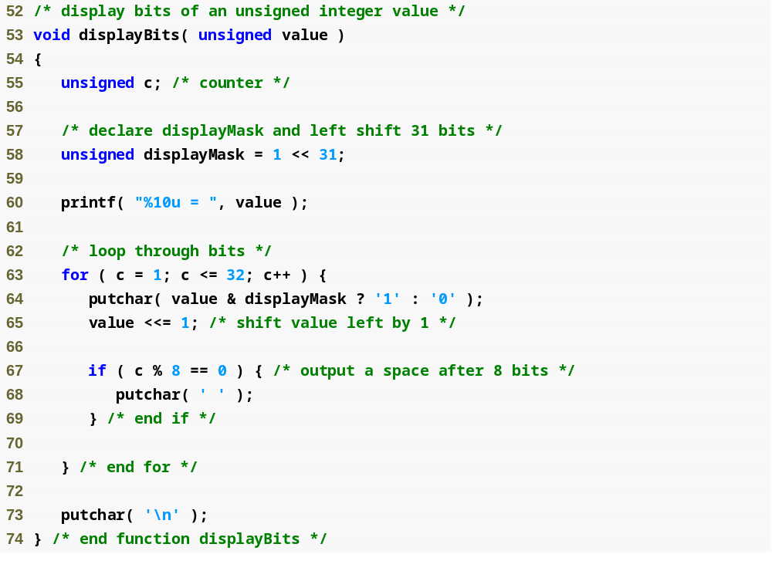

Slide 35
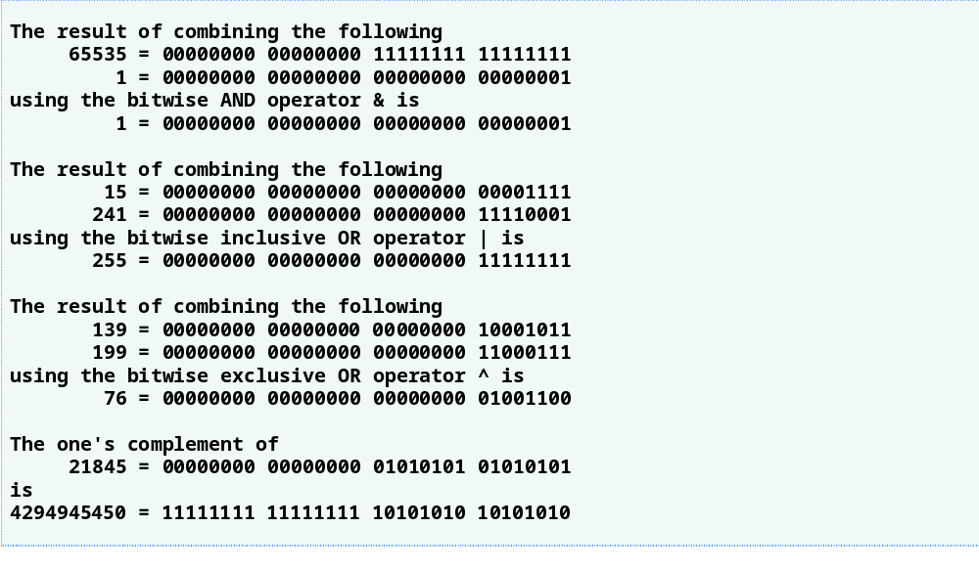

Slide 36
Common Programming Error
Using the logical OR operator (||) for the bitwise OR operator (|) and vice versa is an error.

Slide 37
Bit fields
  Member of a structure whose size (in bits) has been specified
  Enable better memory utilization
  Must be declared as int or unsigned
  Cannot access individual bits. Bit fields are not “arrays of bits.”
Declaring bit fields
  Follow unsigned or int member with a colon (:) and an integer constant representing the width of the field
    Example:
      struct BitCard {
      unsigned face : 4;
      unsigned suit : 2;
      unsigned color : 1;
      };

Slide 38
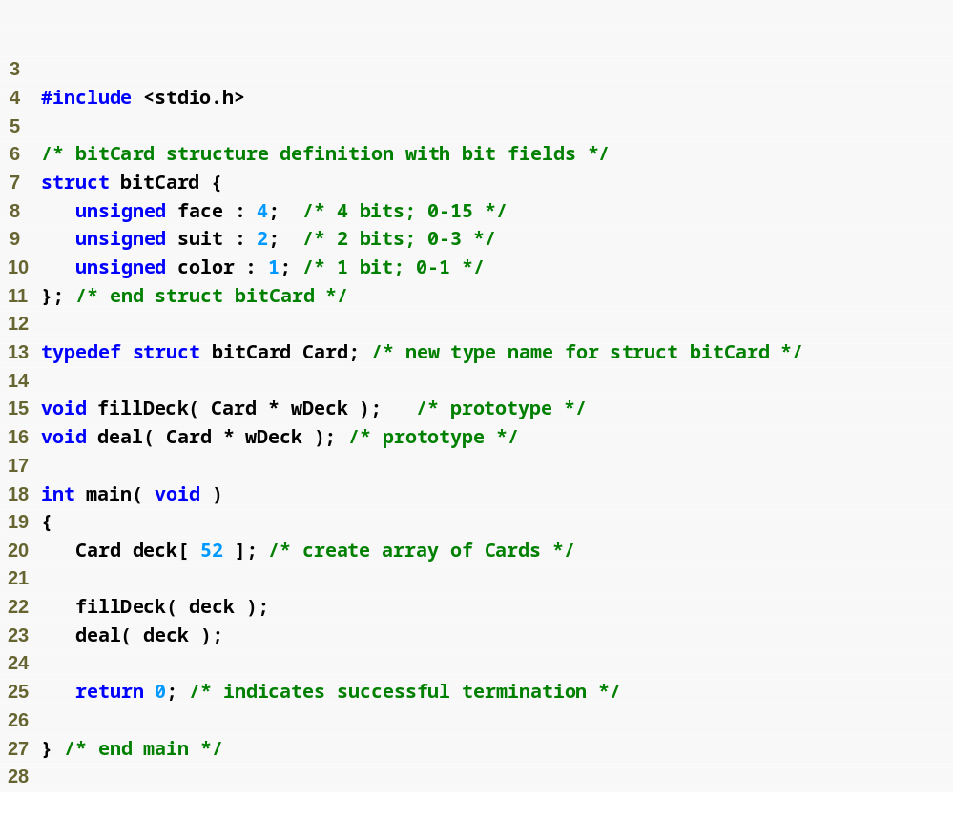
Bit fields determine how much memory each member of a structure can take up

Slide 39
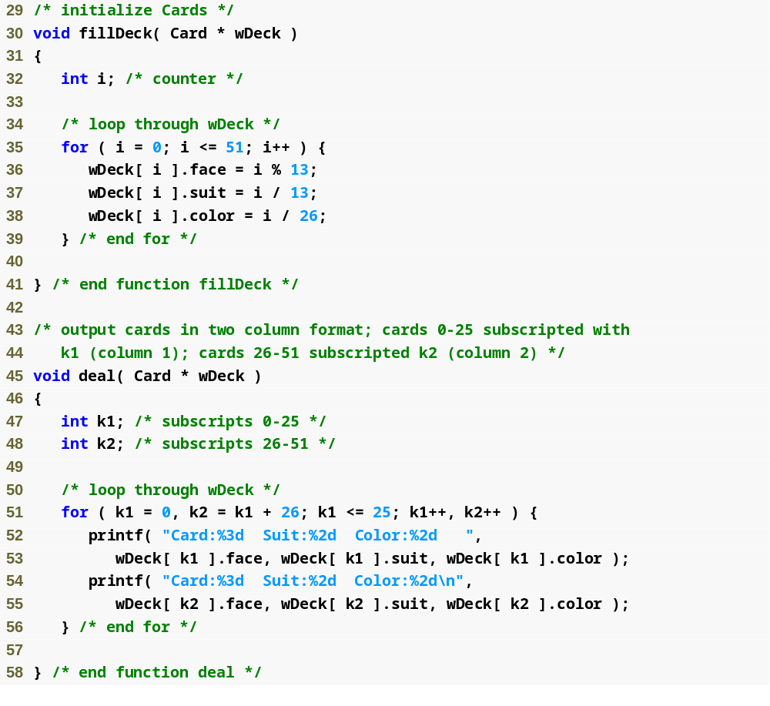

Slide 40
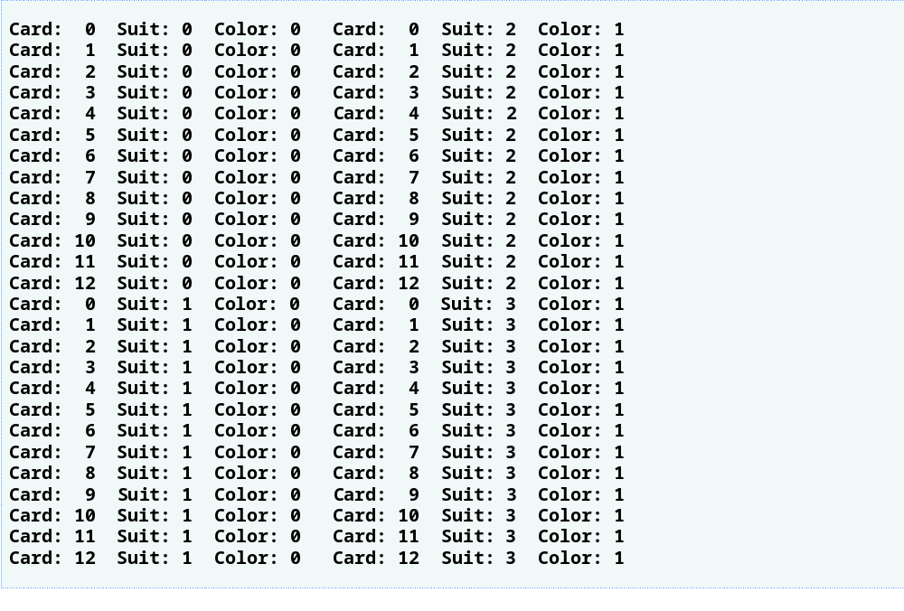

Slide 41
Self-referential structures
A structure that has as its element(s) pointers to the structure itself is called a self-referential structure. E.g. a tree:
typedef struct tree {
DATA d;
struct tree *left, *right;
};
Other classical structures include: stacks, queues and linked lists…

Slide 42
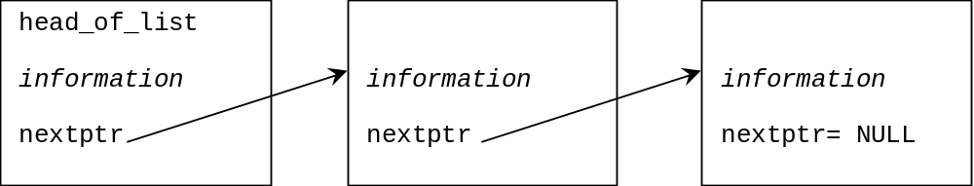
The linked list - a common use of structs which contain themselves
Imagine we are reading lines from a file but don't know how many lines will be read.
We need a structure which can extend itself.
This is known as a linked list. By passing the value of the
head of the list to a function we can pass ALL the information.

Slide 43
How to set up a linked list
typedef struct list_item {
information in each item
struct list_item *nextptr;
} LIST_ITEM;
This structure (where information is what you want each
"node" of your linked list to contain). It is important that
the nextptr of the last bit of the list contains NULL so that
you know when to stop.
head of
list
NULL

Slide 44
Linked list concepts
head of
list
NULL
Adding an item to the middle of the list
head of
list
NULL
move
this
link
new item
points at next item
Deleting an item from the middle of the list
move this link
head of
list
NULL
delete this node

Slide 45
Linear Linked Lists
Problem with arrays: If we assume that they’re of fixed length, need to know maximum length ahead of time. Unrealistic.
Also, even if we did know the maximum length ahead of time, if array was not full, we would be “wasting memory.”
One solution: Linear linked lists.
typedef char DATA;
struct linked_list
{
DATA d;
struct linked_list *next; /* refers to self */
};
typedef struct linked_list ELEMENT;
typedef ELEMENT *LINK;

Slide 46
Linear Linked Lists: List creation
/* Uses recursion. From Kelley/Pohl. */
LINK string_to_list( char s[] )
{
LINK head;
if( s[0] == ‘\0’ )
return NULL;
else
{
head = (LINK) malloc( sizeof( ELEMENT ));
head->d = s[0];
head->next = string_to_list( s + 1 );
return head;
}
}

Slide 47
Linear Linked Lists: Counting
int count( LINK head ) /* recursively: Kelley/Pohl */
{
if( head == NULL )
return 0;
else
return( 1 + count( head->next ));
}
int count_it( LINK head )
{
int cnt;
for( cnt = 0; head != NULL; head = head->next )
{
cnt++;
}
return cnt;
}

Slide 48
Linear Linked Lists: Lookup
/* from Kelley/Pohl */
LINK lookup( DATA c, LINK head )
{
if( head == NULL )
return NULL;
else if( c == head->d )
return head;
else
return( lookup( c, head->next ));
}

Slide 49
Linear Linked Lists: Insertion/Deletion
/* from Kelley/Pohl */
/* Assumes q is a one-element list, and inserts it between
p1 and p2, assumed to be consecutive cells in some list */
void insert( LINK p1, LINK p2, LINK q )
{
p1->next = q;
q->next = p2;
}
void delete_list( LINK head )
{
if( head != NULL )
{
delete_list( head->next );
free( head );
}
}

Slide 50
Linear Linked Lists: write list, main
void writelist( LINK head )
{
while(head != NULL)
{
putchar(head->d);
head = head->next;
}
printf("\n");
}
int main()
{
LINK liste,liste2,liste3,liste4;
liste=string_to_list("abc123");
printf("%d %d \n",count(liste),count_it(liste));
liste2=lookup( 'c', liste );
writelist(liste2);
liste3=string_to_list("efgh");
liste4=string_to_list("d");
insert(liste2,liste3,liste4);
writelist(liste2); writelist(liste);
getch(); return 0;
}
Output:
6 6
c123
cdefgh
abcdefgh

Slide 51
Address book with linked lists
typedef struct list {
char name[MAXLEN];
char address[MAXLEN];
char phone[MAXLEN];
struct list *next;
} ADDRESS;
ADDRESS *hol= NULL;
/* Set the head of the list */

Slide 52
Adding to our address book
void add_to_list (void)
/* Add a new name to our address book */
{
ADDRESS *new_name;
new_name= (ADDRESS *)malloc (sizeof (ADDRESS));
/* CHECK THE MEMORY! */
printf ("Name> ");
fgets (new_name->name, MAXLEN, stdin);
printf ("Address> ");
fgets (new_name->address, MAXLEN, stdin);
printf ("Tel> ");
fgets (new_name->phone, MAXLEN, stdin);
/* Chain the new item into the list */
new_name->next= hol;
hol= new_name;
}

Slide 53
The Binary Tree
A binary tree is a method for storing ordered data (for example a dictionary of words) where we wish to easily be able to add items and find items
Each element in the tree can lead to two further elements – to the left and to the right, representing elements which are earlier in the alphabet and later in the alphabet respectively

Slide 54
The binary tree
NULL
NULL
typedef struct tree {
char word[100];
struct tree *left;
struct tree *right;
} TREE;
NULL
NULL
NULL
NULL
NULL

Slide 55
Binary Tree Pros & Cons
Finding an element is O(log n)
Adding an element is O(log n) – O(1) if we already know where to add it.
Deleting an element may be complex
Programming complexity is higher than a linked list (just about)

Slide 56
Deleting an entire binary tree
I think this code is elegant and worth looking at:
void delete_tree (TREE *ptr)
{
if (ptr == NULL)
return;
delete_tree(ptr->left);
delete_tree(ptr->right);
free (ptr);
}
We can delete the whole tree with:
delete_tree(root_of_tree);

Slide 57
Stacks
Another form of data abstraction: will implement using ideas similar to those used in implementing linear linked list.
Only two basic operations defined on a stack: push (insertion), pop (deletion).
Access is restricted to the “head” of the stack.
#define NULL 0
typedef char DATA;
struct stack
{
DATA d;
struct stack *next; /* refers to self */
};
typedef struct stack ELEMENT;
typedef ELEMENT *LINK;

Slide 58
Stacks: Testing for emptiness, Top element
int isempty( TOP t )
{
return( t == NULL );
}
DATA vtop( TOP t )
{
return( t -> d );
}

Slide 59
Stacks: Pop
/* remove top element from the stack */
void pop( TOP *t, DATA *x )
{
TOP t1 = *t;
if( !isempty( t1 ))
{
*x = t1->d;
*t = t1->next;
free( t1 );
}
else
printf( “Empty stack.\n” );
}

Slide 60
Stacks: Push
/* put an element at the top of the stack */
void push( TOP *t, DATA x )
{
TOP temp;
temp = malloc( sizeof( ELEMENT ));
temp->d = x;
temp->next = *t;
*t = temp;
}

Slide 61
Referance
Ioannis A. Vetsikas, Lecture notes
Dale Roberts, Lecture notes

